Slide 1
Duncan Ross
Director, data and analytics
Times Higher Education

Slide 2
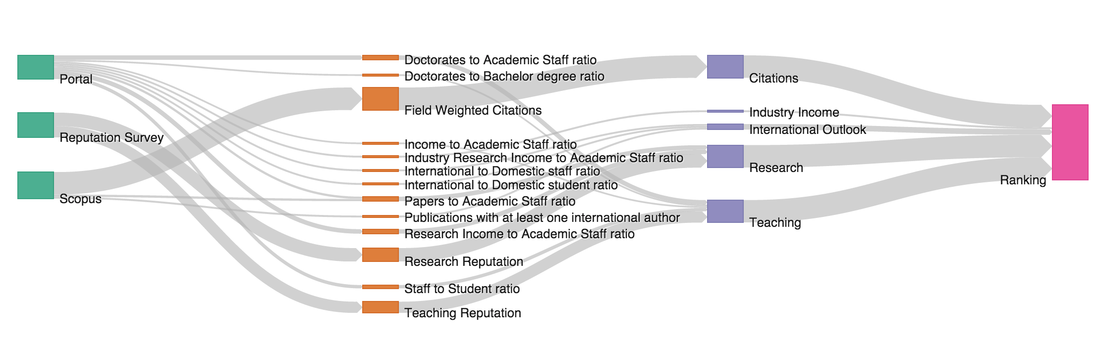
A brief overview of THE methodology
Data Sources
5 Pillars
(Published)
13 Metrics
(Not published)

Slide 3
Criteria for participation:
More than 1000 scholarly articles
From Elsevier’s Scopus database
Articles, reviews, books, conference papers
200 per year (some scope for movement)
2010-2014 (for last year)
2011-2015 (for this year)
  Data collated in July
Universal education
We require activity in more than one of the subject areas
Undergraduate teaching
Teach at undergraduate level
Evidence of significant number of undergraduate students

Slide 4
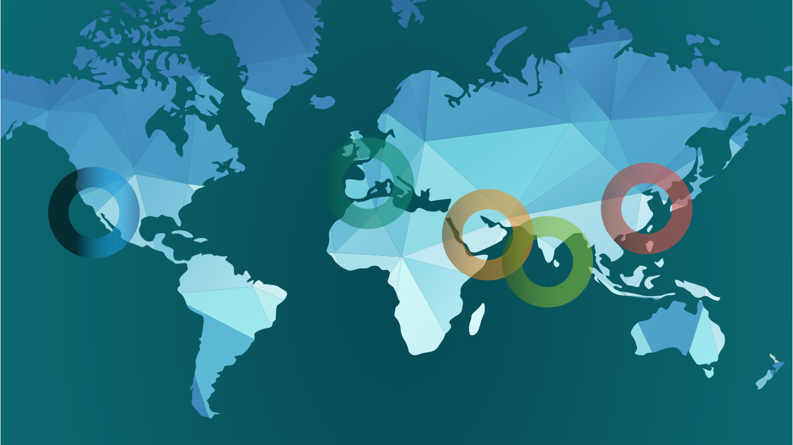
Covering the top research focused universities
2004
200 Universities
2010
400 Universities
2015
800 Universities
70 countries
78 UK universities
4%

Slide 5
Subject level coverage
Two new subjects in 2016-17: Business, Computer Sciences
Extended information up to 31 taught subjects
 | Doctorates to academic staff | Doctorates to bachelor’s degrees awarded | Teaching reputation | Income to academic staff | Staff to student ratio | Papers to academic staff | Research income to academic staff | Research reputation | Field Weighted Citations | Industry research income to academic staff | International to domestic staff | International to domestic student | Publications with international author
WUR | 6 | 2.25 | 15 | 2.25 | 4.5 | 6 | 6 | 18 | 30 | 2.5 | 2.5 | 2.5 | 2.5
Arts | 4.7 | 1.9 | 25.3 | 1.9 | 3.8 | 3.8 | 3.8 | 30 | 15 | 2.5 | 2.5 | 2.5 | 2.5
Clinical | 4.1 | 1.4 | 17.9 | 1.4 | 2.8 | 4.1 | 4.1 | 19.3 | 35 | 2.5 | 2.5 | 2.5 | 2.5
Eng & Tech | 4.5 | 1.5 | 19.5 | 1.5 | 4.5 | 4.5 | 4.5 | 21 | 27.5 | 5 | 2.5 | 2.5 | 2.5
Social Science | 4.9 | 1.6 | 21.1 | 1.6 | 3.3 | 4.9 | 4.9 | 22.8 | 25 | 2.5 | 2.5 | 2.5 | 2.5
Physical Science | 6 | 2.25 | 15 | 2.25 | 4.5 | 6 | 6 | 18 | 30 | 2.5 | 2.5 | 2.5 | 2.5
Life Science | 6 | 2.25 | 15 | 2.25 | 4.5 | 6 | 6 | 18 | 30 | 2.5 | 2.5 | 2.5 | 2.5

Slide 6
Challenges to the UK:
Reputation

Slide 7
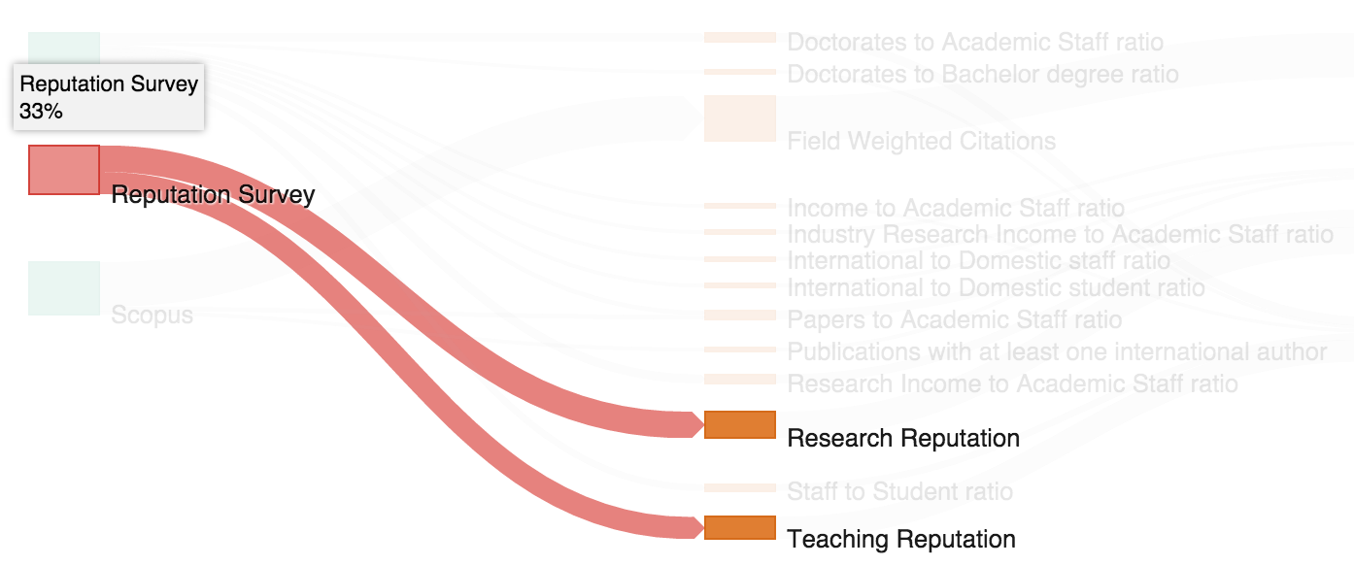
Academic reputation survey
Subjective data
“Brand”
Survey of academics selected by Elsevier
Balanced by geography
  UNESCO data
10,500 responses

Slide 8
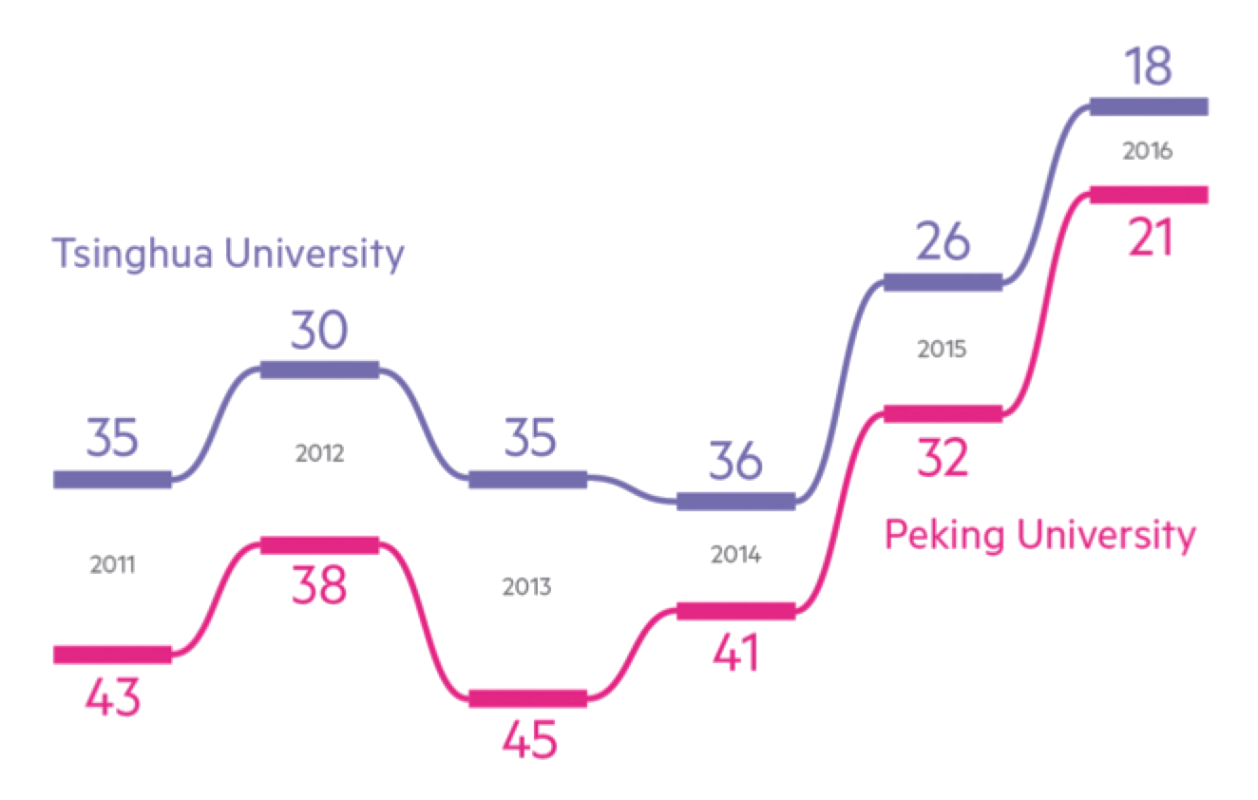
Reputation changes over time
Notes:
For me, China’s rise is the story of the year. Its top two Peking and Tsinghua, have made outstanding progress over the six years we’ve been running this survey. And now joined by three more in the global elite higher education brands.
A big story. Combine this also with the success of Hong Kong this year – Hong Kong University is back in the world top 50. And HK has three in the top 100 overall, up from two last year, as Chinese University of Hong Kong joins HKUST in the 71-80 band.

Slide 9
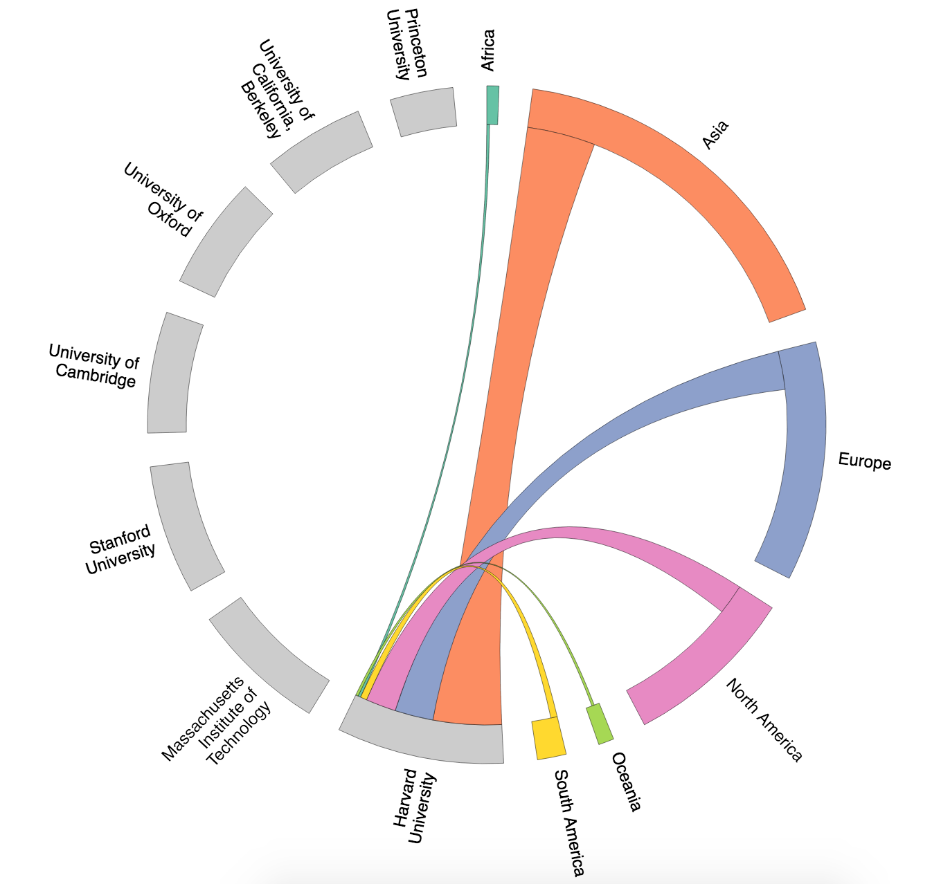
Where do universities get support?
One of the features of the Universities with the highest reputation is the breadth of their support
All receive large votes from every region
Harvard receives stronger recognition from Asia than from North America

Slide 10
Eurovision effect: do countries vote for themselves?
There is some evidence that academics vote for universities in their country or region
Some countries rely heavily on this
Others are hugely international

Slide 11
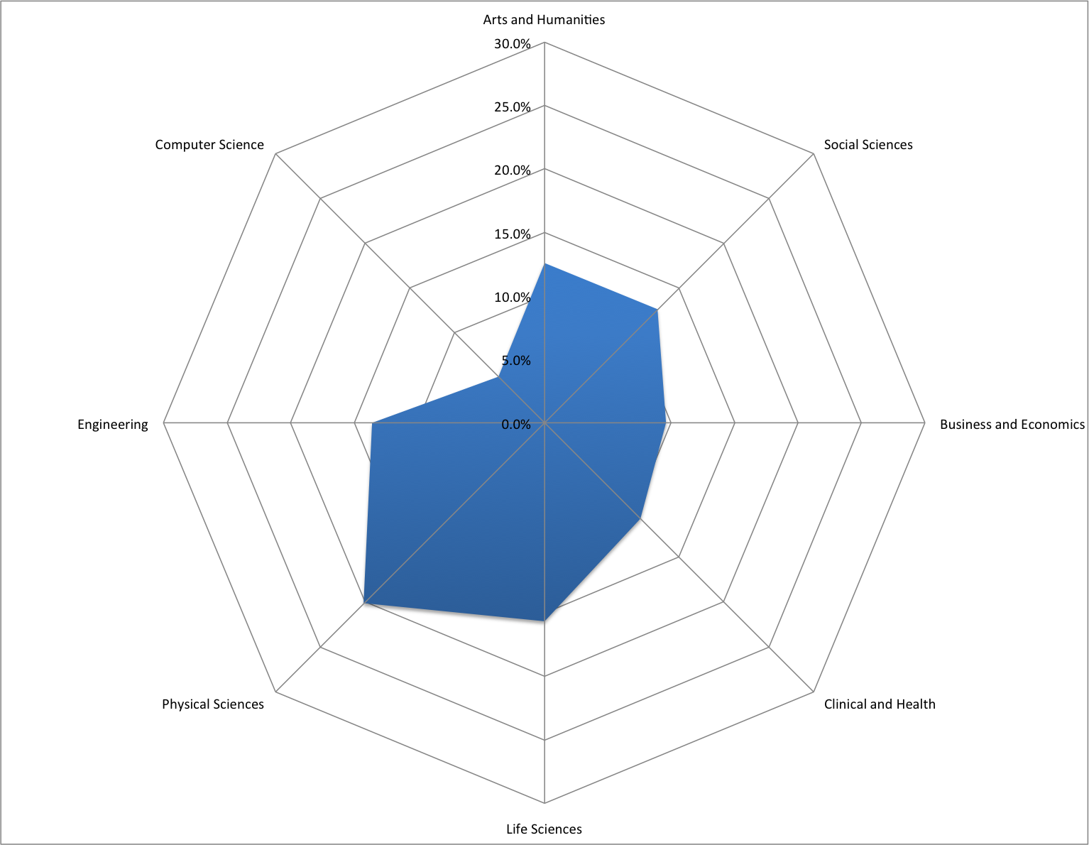
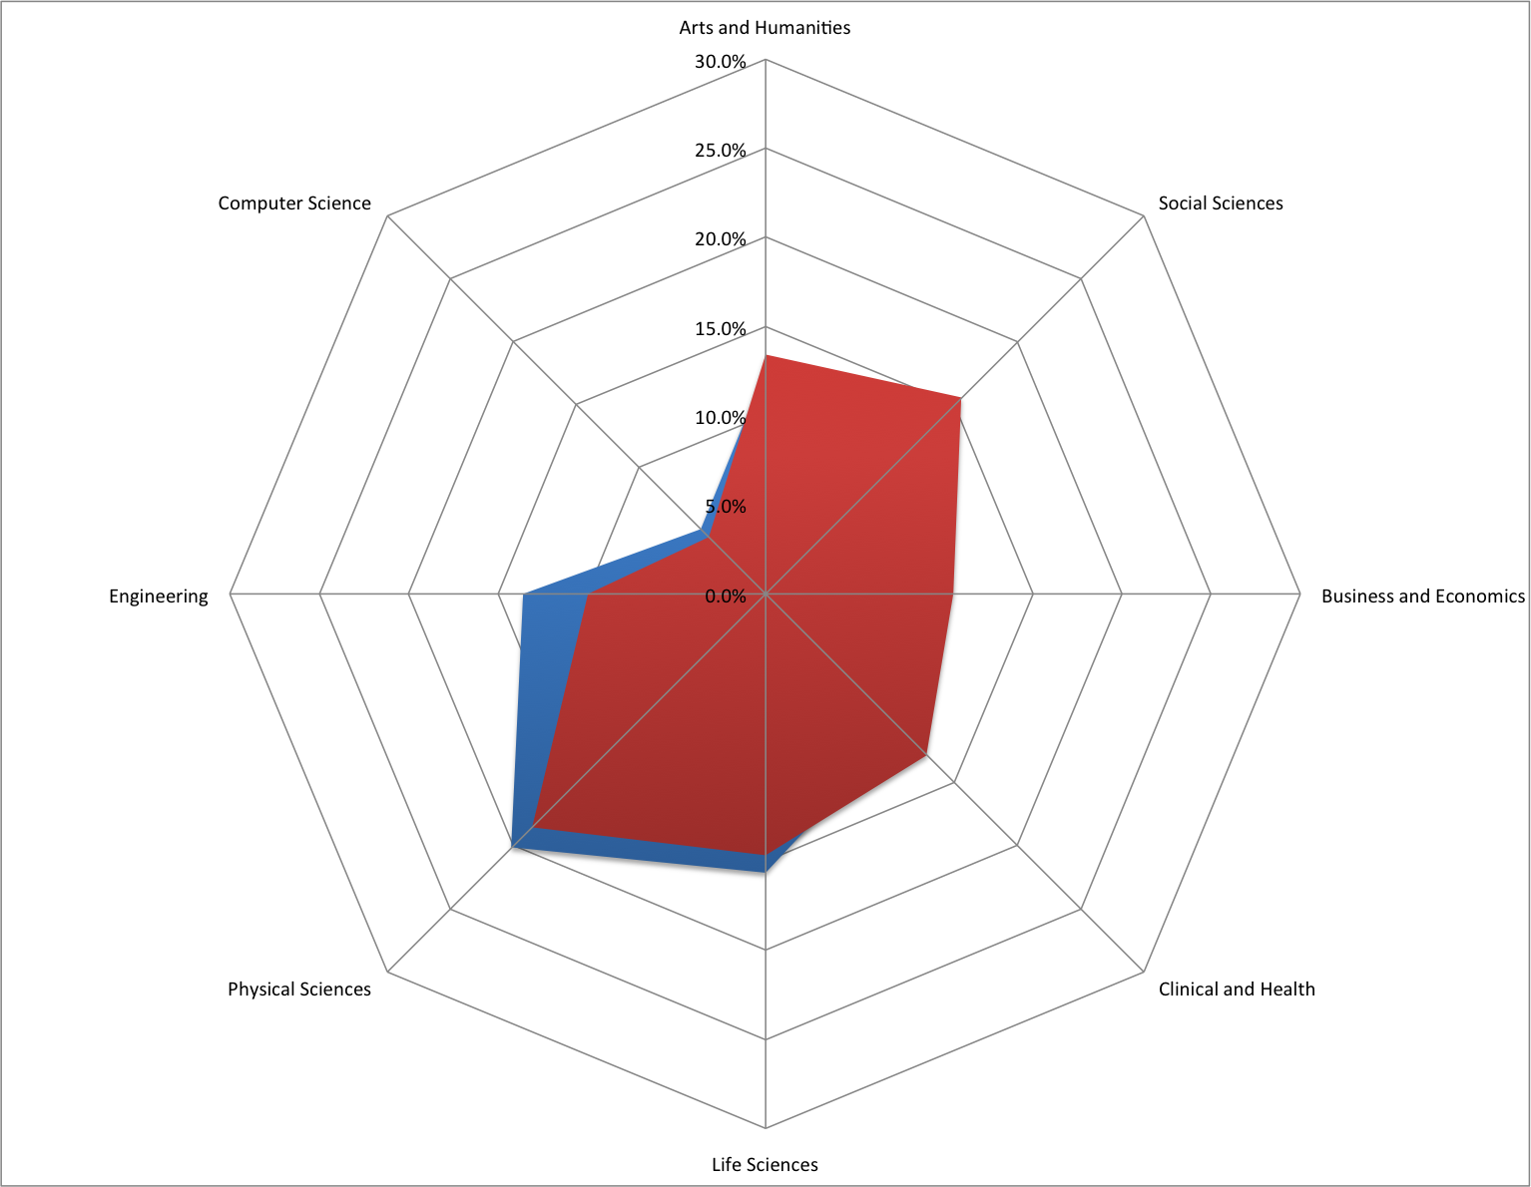
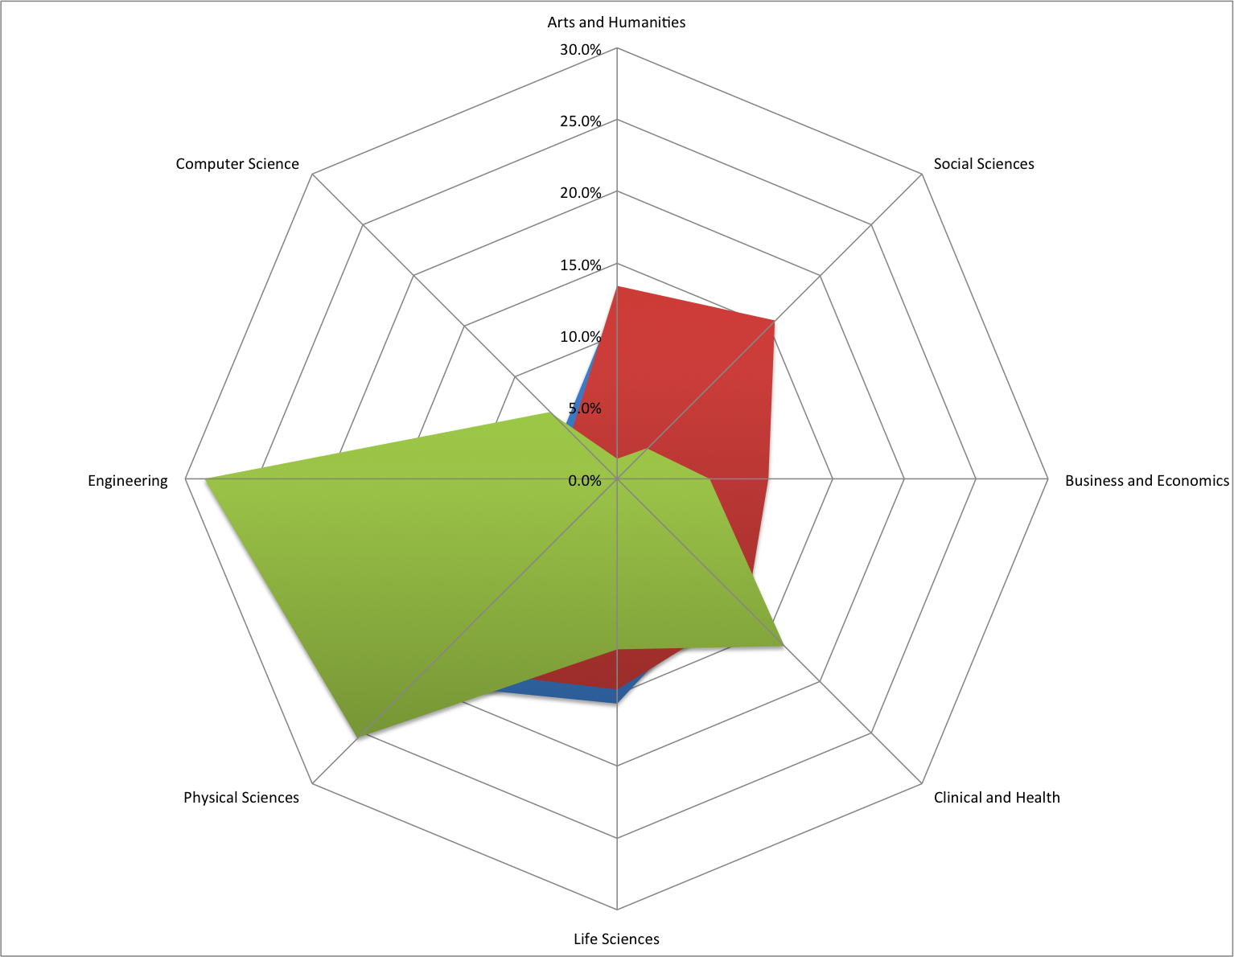
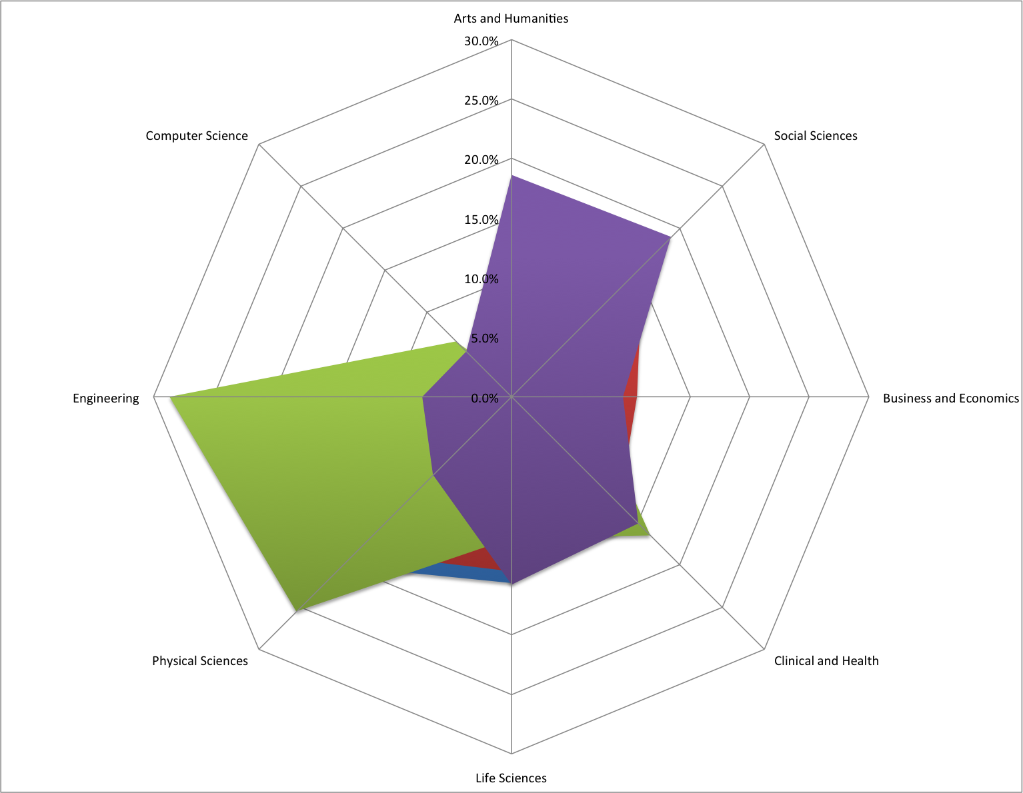
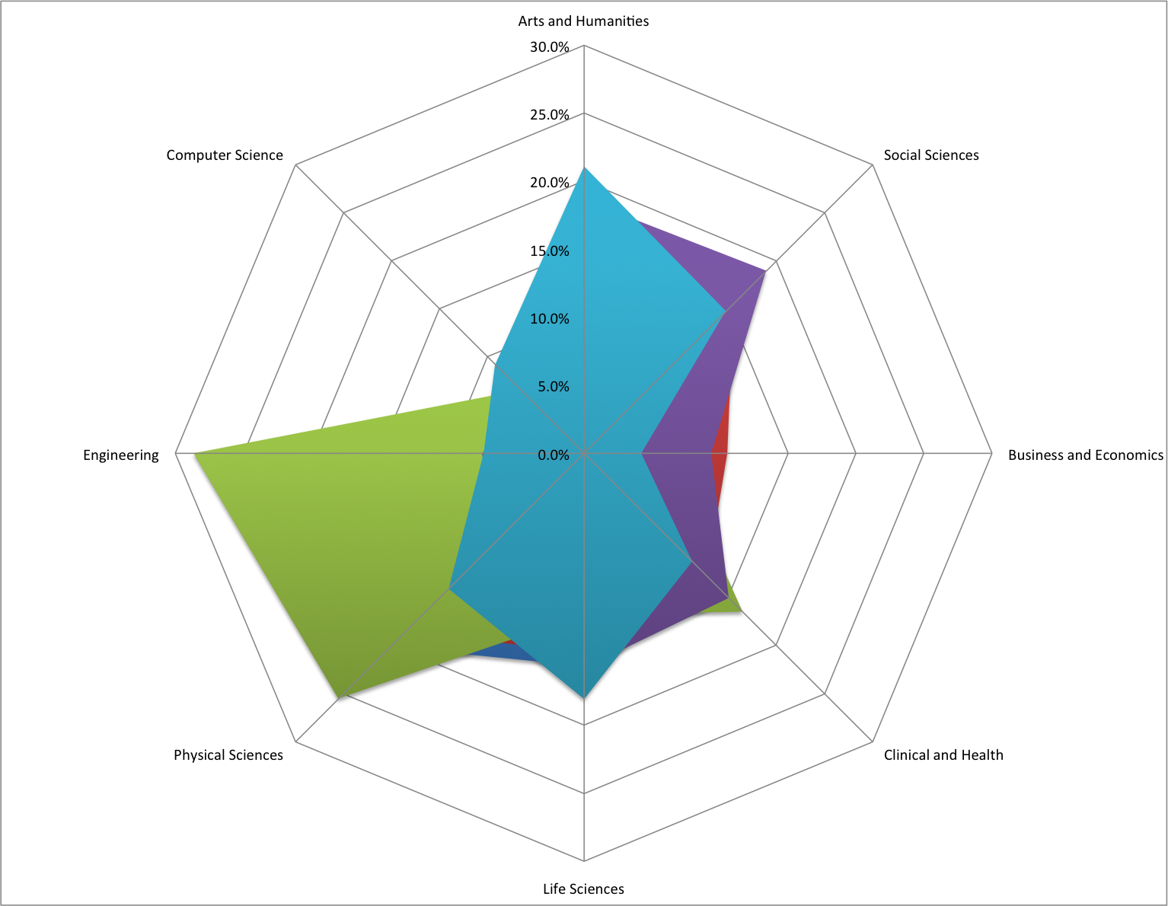
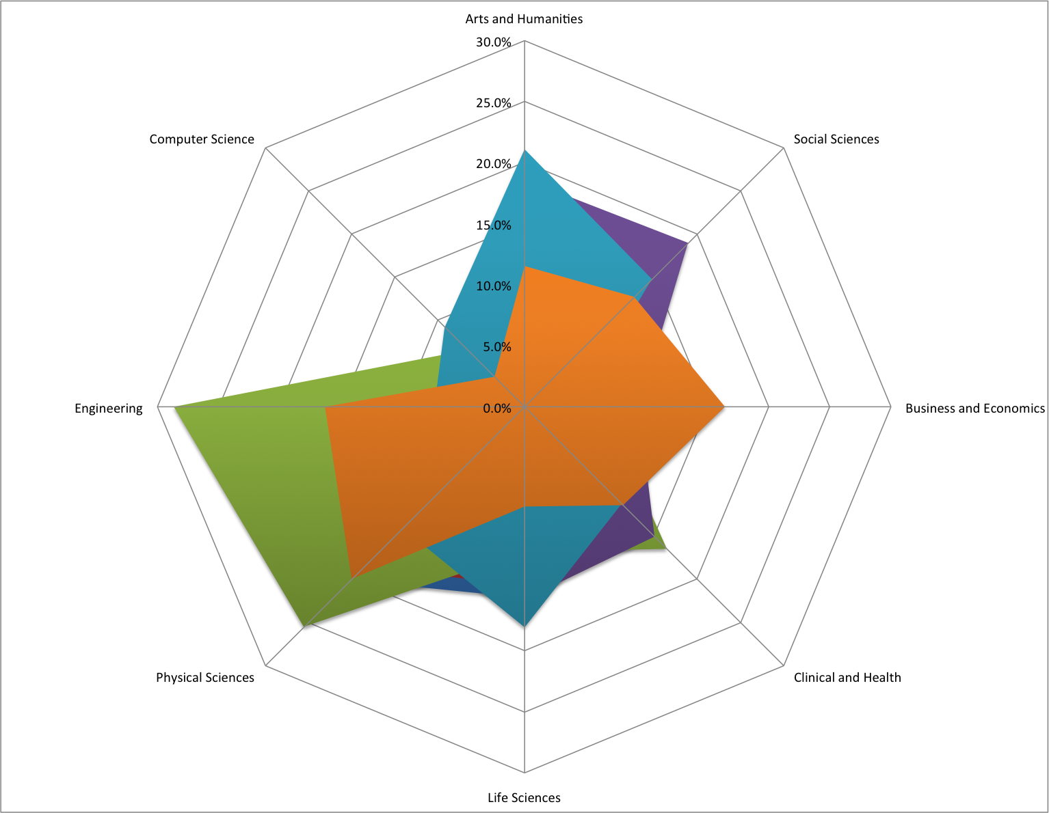
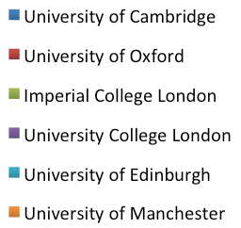
Understand where your reputational strengths are

Slide 12
Challenges to the UK:
Research, teaching and investment

Slide 13
How should UK universities be grouped?
Cluster | Number | Examples
Emerging Talents | 1 | Huddersfield
Developing Expertise | 5 | Nottingham Trent, Coventry, Central Lancashire
Core Strengths | 24 | Essex, Sheffield Hallam, Strathclyde
Effective Publishers | 9 | Swansea, Aston, Heriot-Watt
Technology Challengers | 3 | Newcastle, Leicester, Surrey
Life Science Challengers | 29 | Dundee, Loughborough, Birmingham
International Powerhouse | 5 | Manchester, Imperial, Edinburgh
Old Stars | 2 | Cambridge, Oxford

Slide 14
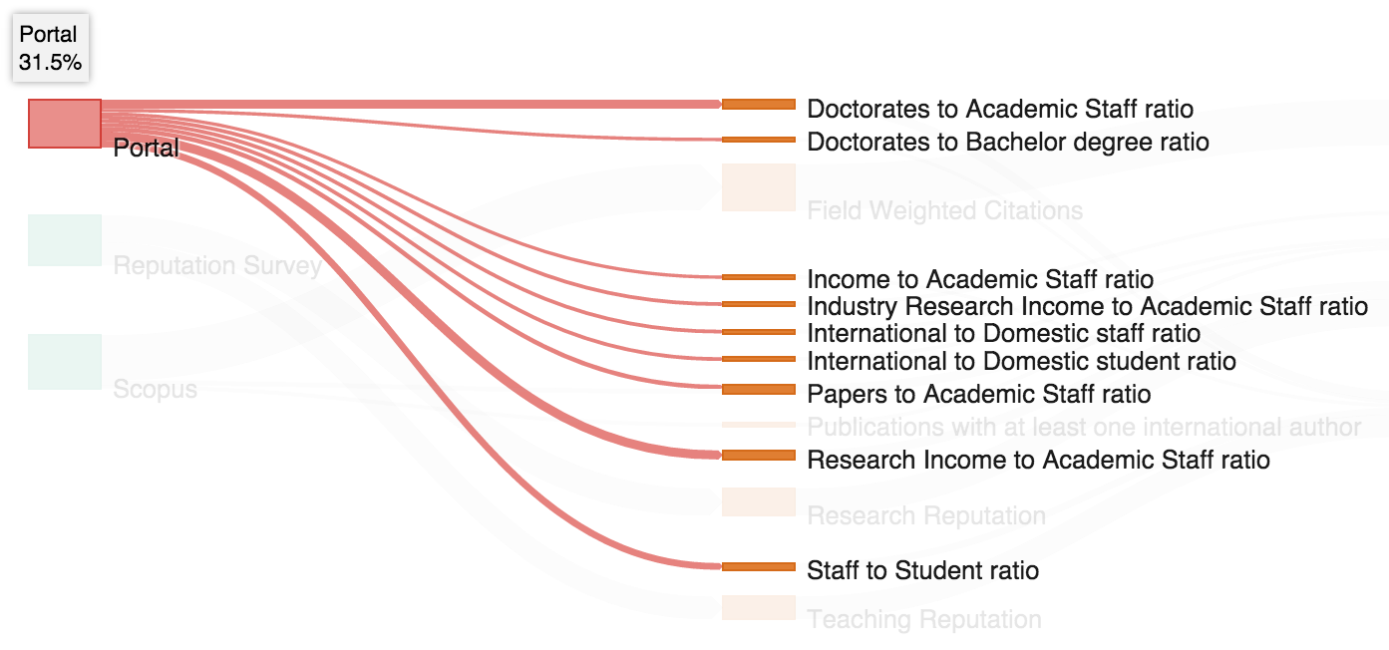
Directly provided University data
Objective measures of capacity
Details at institutional and subject level
Data prepopulated where possible
  UK & USA from public data
Data gathered Spring
Reflects 2013 data
  Challenges of different systems

Slide 15
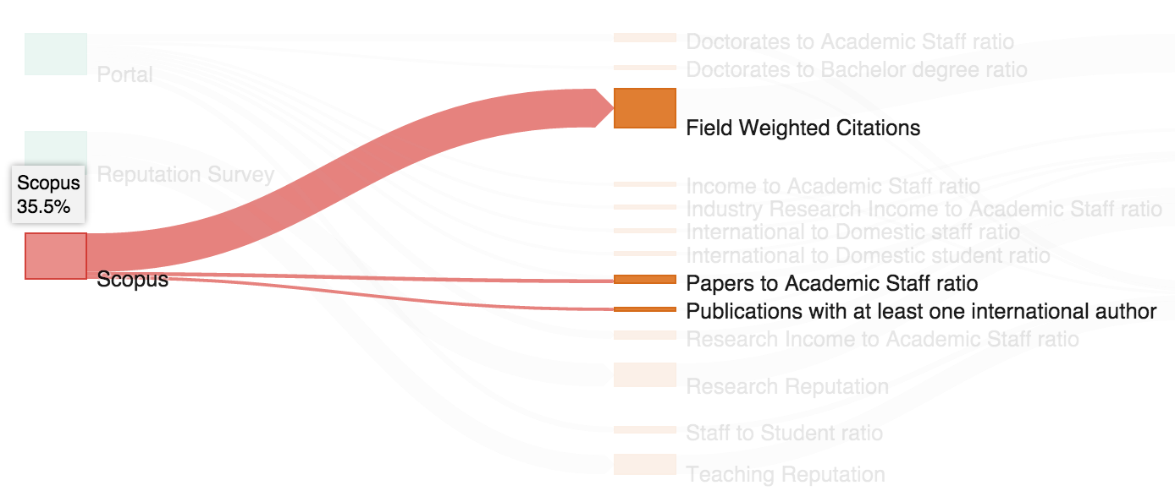
Bibliometric measures from Scopus
Moved from Thomson Reuters Web of Science to Elsevier’s Scopus
Three measures
Field Weighted Citations to avoid subject bias

Slide 16
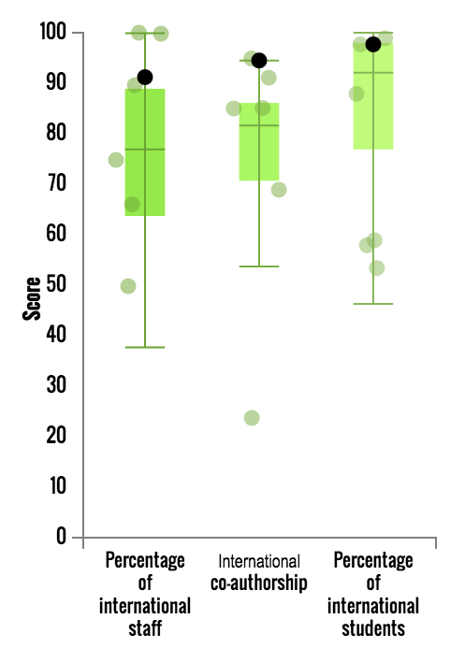
International Outlook in the UK
Box and whiskers plots show the distributions of all UK institutions in the World University Rankings
Great Universities act on the world stage
Data focus on
  Ability to recruit internationally
  Research links
How does the UK do?
UK does very well on all international measures
This is both a strength, and a vulnerability

Slide 17
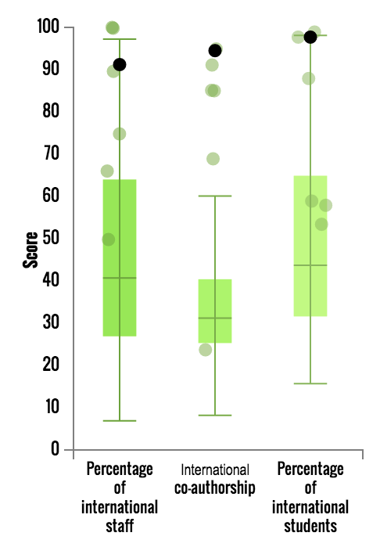
International Outlook in the UK vs USA
Stronger across the board
A particular challenge in the USA is the increasing emphasis on in-state students within the state systems
UK
USA

Slide 18
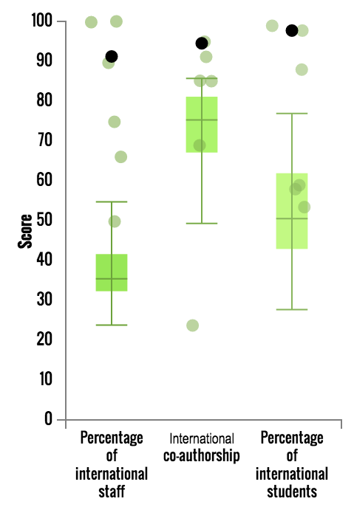
International Outlook in the UK vs Germany
There are indications that Germany is starting to think more internationally
Significant increase in international students in Germany
Increasing willingness to teach in English
UK
Germany

Slide 19
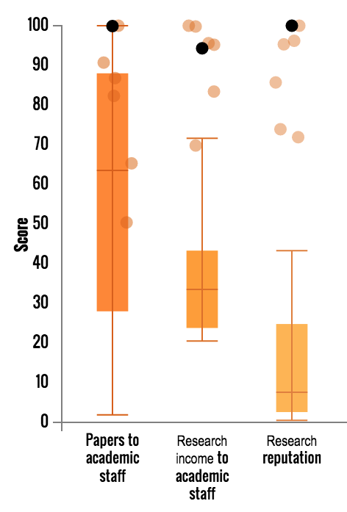
Research inputs in the UK
Research is another key area of focus
Data focus on
  Productivity
  Research income
  Academic reputation
How does the UK do?
The UK has very varied productivity measures
Research income is left-skewed – there is a long tail of institutions with strong income

Slide 20
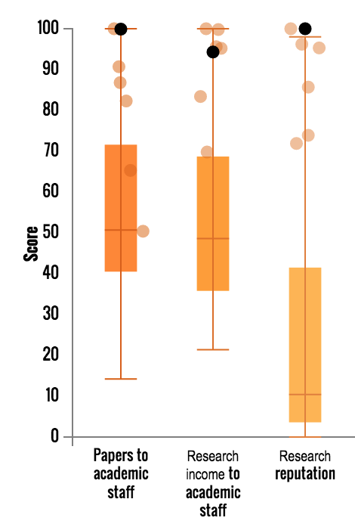
Research in the UK vs USA
The UK leads on productivity
Research income stronger and more equal in the US
Reputation stronger in the US, although median very similar
UK
USA

Slide 21
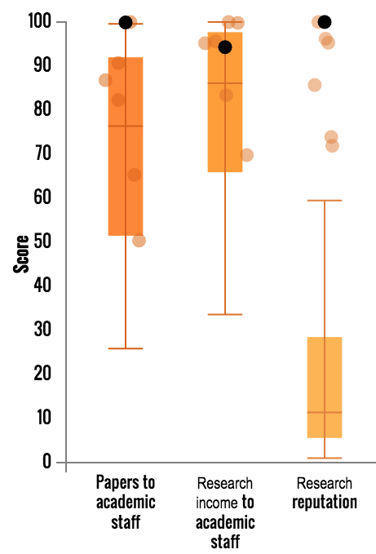
Research in the UK vs Germany
German productivity higher
Research income much stronger
UK
Germany

Slide 22
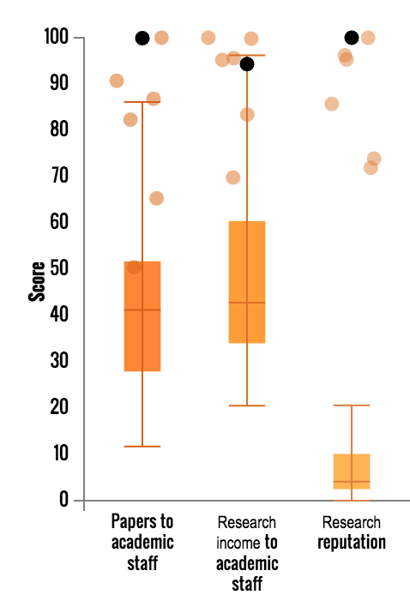
Research in the UK vs China
Productivity weaker in China
Income already beating UK
Reputationally weak
UK
China

Slide 23
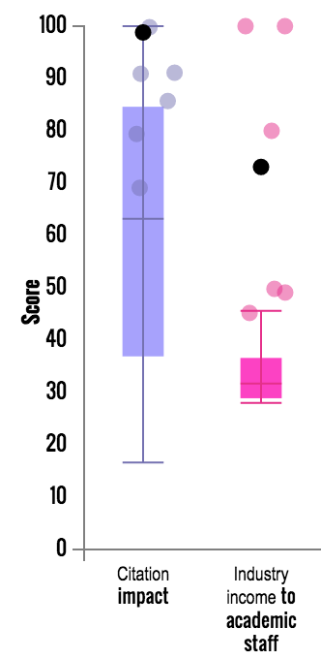
Citations and Industry Income in the UK
Citation Impact measures quality of output
Field weighted across 334 subjects
Articles, Reviews, Conference papers
2010-2014 (inclusive)
Industry Income represents the ability to persuade business to partner with academia
Relies on effect output
How does the UK do?
Generally strong on citations – gaining the benefit of English
Industry income tightly grouped and relatively weak

Slide 24
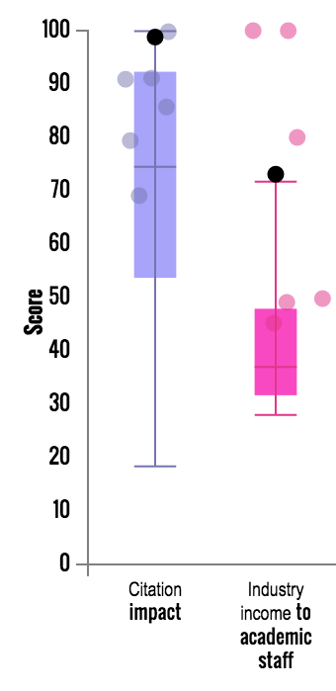
Citations and Industry Income in the UK vs USA
US leads on income and citations
More US institutions are performing strongly in terms of citations – right skew
Caveats:
This represents most, but not all of the US R1 institutions, and some R2 institutions
Financial data has been converted using PPP to ensure comparability
UK
USA

Slide 25
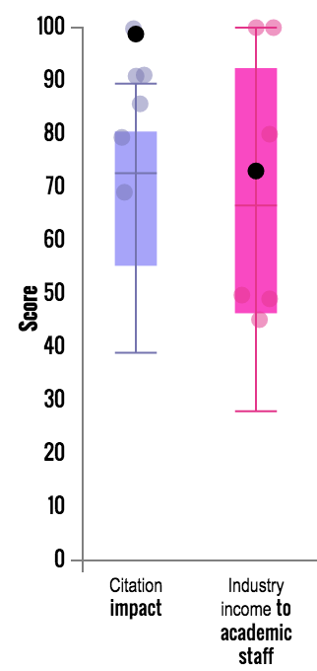
Citations and Industry Income in the UK vs Germany
German industry links deeper and stronger
Citations mixed – higher median, but not as strong amongst the leading universities
UK
Germany

Slide 26
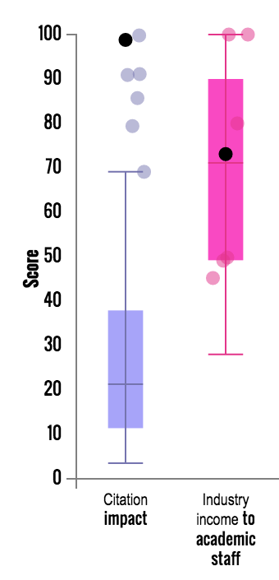
Citations and Industry Income in the UK vs China
Much stronger industry focus
Citations much weaker – facing the challenge of English
However increasing state pressure on English publication
UK
China

Slide 27
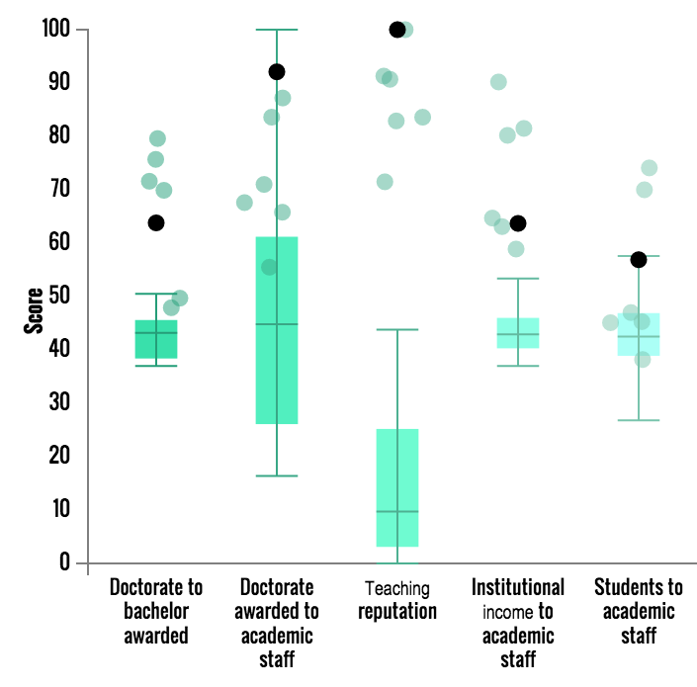
Teaching in the UK
Teaching reflects a crucial mission
Data focus on
  “Presage” the capacity to teach
  Reputation for ability to teach
How does the UK perform?
Three metrics are very tightly grouped
Doctorate to bachelor degrees,
Institutional income to academic staff, and
Students to academic staff
Teaching reputation shows the usual exponential ‘long tail’

Slide 28
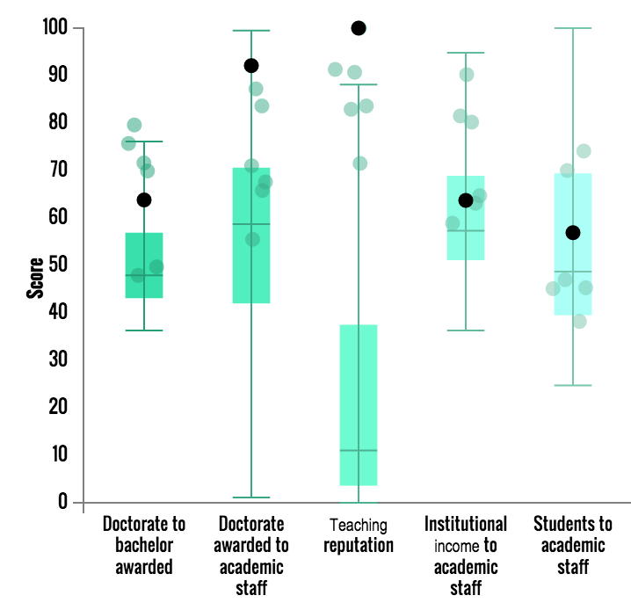
Teaching in the UK vs USA
The diversity of the US system clearly shows in the data, as does financial strength
UK
USA

Slide 29
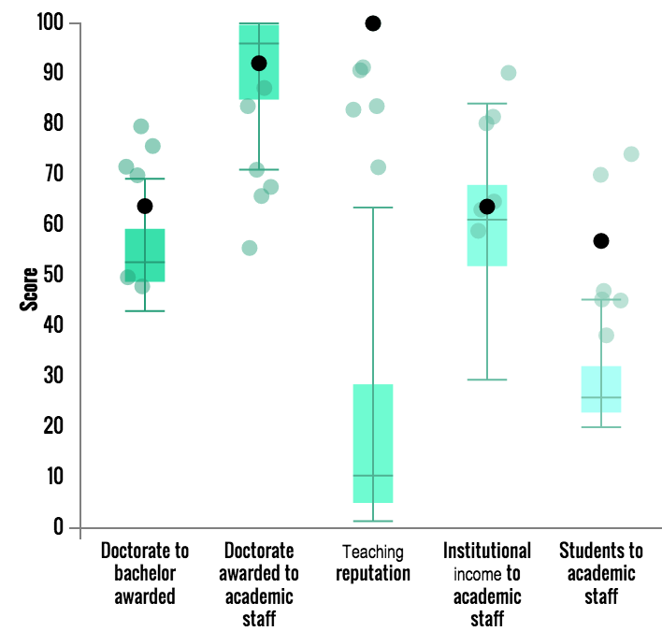
Teaching in the UK vs Germany
Germany has a stronger focus on post-graduate learning, especially doctorates
Again, better financed than the UK
UK
Germany

Slide 30
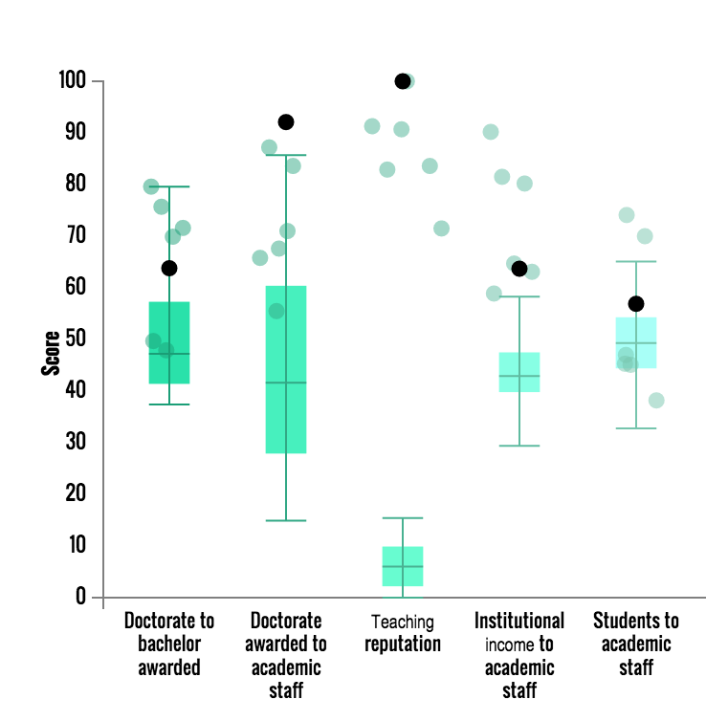
Teaching in the UK vs China
Lower teaching reputation
Similar funding
Slightly stronger Student to staff ratio
UK
China

Slide 31
Conclusions
The data shows that UK universities face significant challenges – from emerging nations as well as traditional competitors
International systems are willing to change to adopt the best from UK
France becoming more universal
Germany reaching out to foreign students
Other systems also have their challenges
Japan facing student shortages
USA facing pressure of “value”
Despite the failure of AHELO, teaching is going to increasingly be seen as a key international benchmark

Slide 32
Thank you
duncan.ross@tesglobal.com
@duncan3ross

